Slide 1
ancestor, ancestry
origin, origins
heritage
descend from, descendants
Notes:
These words will be used in the presentation – when they come up it will be useful to explain them to pupils emphasising that ancestry and descended from refers to more distant times whereas origins is more recent e.g. a British person of Polish origins may have two parents who were both born in Poland. As a follow-up pupils could look up definitions and synonyms of these words – in four groups and present them as a spider diagram on A3 paper.

Slide 3
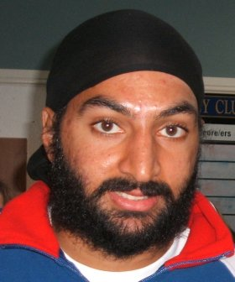
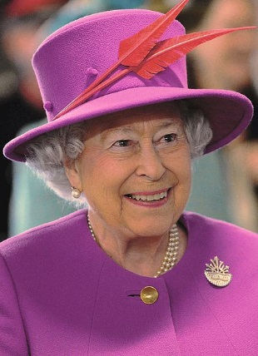
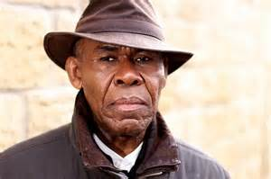
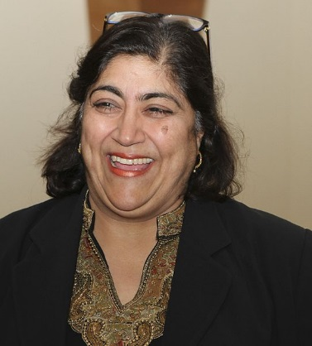
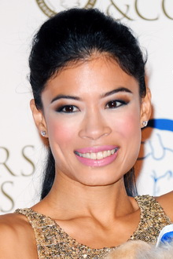
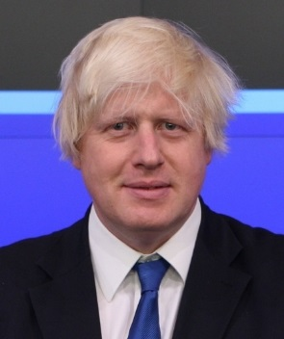
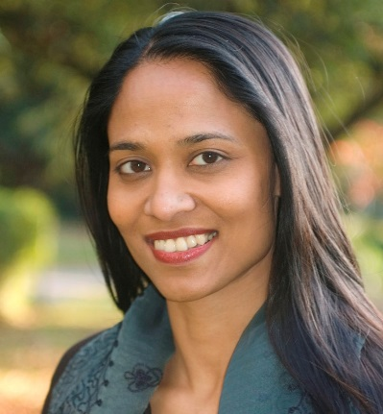
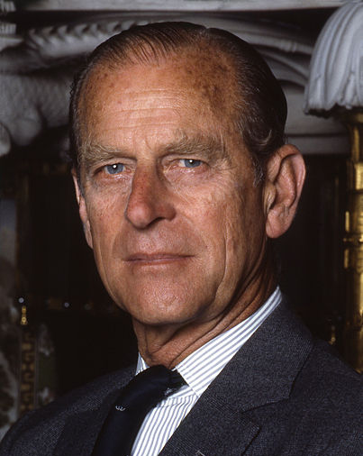
Notes:
Ask the pupils how many of these people they recognise.
Ask them to talk to their partner, or in a small group. Ask each pair/group who they have recognised (in some cases they may recognise without being able to name). You can list their suggestions.
Ask them what they might all have in common. If someone suggests the their origins acknowledge without saying it is the correct answer – you could say it is one of the things they might have in common.
Again talking in pairs/small group, collect their suggestions – allowing some discussion and building on or dismissing each others’ suggestions.
Ask the pupils if they can suggest what type of jobs they might do. The next slide explores this.
Acknowledgements of photos used – where required
Helen Czerski photo by Benjamin Ellis at http://flickr.com/photos/29034542@N00/7302576952
Sharon Osbourne by Eva Rinaldi on Flickr
Vanessa-Mae by LondonPictureCapital http://www.flickr.com/photos/14888585@N06/15720252581/
Boris Johnson *Boris Johnson -opening bell at NASDAQ-14Sept2009.jpg: Think London Snowmanradio (talk) Off2riorob (talk)
HM Elizabeth II Joel Rouse/ Ministry of Defence https://www.defenceimagery.mod.uk/fotoweb/archives/5000-Current%20News/Archive%20(Navy)/RoyalNavy/2015/March/45158590.jpg
Prince Phillip Allan warren
Gus John cropped photo Ashley Karrell Photography (www.ashleykarrell.com/).

Slide 4
Mayor of London
Husband of the queen
Writer, academic, campaigner
Classical violinist
Politician, Labour MP
Soldier
TV Presenter, businesswoman
Physicist, oceanographer and broadcaster
Doctor
Religious leader
Queen of Britain
English international cricketer
Actor
Police Officer
Film director
Notes:
Now ask them if they can identify what each person does, what is their job/occupation. Explain to the children that some additional jobs have been added – you can say that this is to make it a little more challenging.
The pupils, in a group or pairs,` should be give a printed black and white copy of slide No 8 and asked to work out who does which job.
Go through each of the jobs asking a group or pair who they think does that job. Consider asking pupils who are fairly recently arrived in the UK - who has the job of queen, who is Mayor of London. Do ask all pupils about how they made their choices, what information did they have, what helped them decide/make a guess. You can explore with the pupils any stereotypes, prejudicial ideas they have – through questioning – you can get them to reflect on where they got these ideas from. You can encourage other pupils to disagree and make alternative suggestions. It is good to explore both
Acknowledgements of photos used – where required
Helen Czerski photo by Benjamin Ellis at http://flickr.com/photos/29034542@N00/7302576952
Sharon Osbourne by Eva Rinaldi on Flickr
Vanessa-Mae by LondonPictureCapital http://www.flickr.com/photos/14888585@N06/15720252581/
Boris Johnson *Boris Johnson -opening bell at NASDAQ-14Sept2009.jpg: Think London Snowmanradio (talk) Off2riorob (talk)
HM Elizabeth II Joel Rouse/ Ministry of Defence https://www.defenceimagery.mod.uk/fotoweb/archives/5000-Current%20News/Archive%20(Navy)/RoyalNavy/2015/March/45158590.jpg
Prince Phillip Allan warren
Gus John cropped photo Ashley Karrell Photography (www.ashleykarrell.com/).

Slide 5
Mayor of London
Husband of the queen
Writer, academic, campaigner
Classical violinist
Politician, Labour MP
Soldier
TV Presenter, businesswoman
Physicist, oceanographer and broadcaster
Doctor
Religious leader
Queen of Britain
English international cricketer
Actor
Police Officer
Film director
Notes:
Now ask them if they can identify what each person does, what is their job/occupation. Explain to the children that some additional jobs have been added – you can say that this is to make it a little more challenging.
The pupils, in a group or pairs,` should be give a printed black and white copy of the slide and asked to work out who does which job.
Go through each of the jobs asking a group or pair who they think does that job. Consider asking pupils who are fairly recently arrived in the UK - who has the job of queen, who is Mayor of London. Do ask all pupils about how they made their choices, what information did they have, what helped them decide/make a guess. You can explore with the pupils any stereotypes, prejudicial ideas they have – through questioning – you can get them to reflect on where they got these ideas from. You can encourage other pupils to disagree and make alternative suggestions. It is good to explore both
Acknowledgements of photos used – where required
Helen Czerski photo by Benjamin Ellis at http://flickr.com/photos/29034542@N00/7302576952
Sharon Osbourne by Eva Rinaldi on Flickr
Vanessa-Mae by LondonPictureCapital http://www.flickr.com/photos/14888585@N06/15720252581/
Boris Johnson *Boris Johnson -opening bell at NASDAQ-14Sept2009.jpg: Think London Snowmanradio (talk) Off2riorob (talk)
HM Elizabeth II Joel Rouse/ Ministry of Defence https://www.defenceimagery.mod.uk/fotoweb/archives/5000-Current%20News/Archive%20(Navy)/RoyalNavy/2015/March/45158590.jpg
Prince Phillip Allan warren
Gus John cropped photo Ashley Karrell Photography (www.ashleykarrell.com/).

Slide 6
Oceanographer, physicist and broadcaster
Politician, Labour MP
English international cricketer
Film director
TV presenter, businesswoman
Classical violinist
Mayor of London
Queen of England
Writer, academic, campaigner
Husband of the queen
Notes:
This slide reveals the answers about jobs, before revealing each one choose pupils who have not spoken much to suggest the answer. Perhaps if someone is relatively recently arrived and you know they have the correct answer – it is an opportunity to get them to answer.
When revealing the answers you may want to explain a bit what some of the jobs are.
Acknowledgements of photos used – where required
Helen Czerski photo by Benjamin Ellis at http://flickr.com/photos/29034542@N00/7302576952
Sharon Osbourne by Eva Rinaldi on Flickr
Vanessa-Mae by LondonPictureCapital http://www.flickr.com/photos/14888585@N06/15720252581/
Boris Johnson *Boris Johnson -opening bell at NASDAQ-14Sept2009.jpg: Think London Snowmanradio (talk) Off2riorob (talk)
HM Elizabeth II Joel Rouse/ Ministry of Defence https://www.defenceimagery.mod.uk/fotoweb/archives/5000-Current%20News/Archive%20(Navy)/RoyalNavy/2015/March/45158590.jpg
Prince Phillip Allan warren
Gus John cropped photo Ashley Karrell Photography (www.ashleykarrell.com/).

Slide 7
HM Elizabeth II
Gus John
Prince Philip
Boris Johnson
Rushanara Ali,
Monty Panesar
Sharon Osbourne
Helen Czerski,
Vanessa-Mae
Gurinder Chadha
Notes:
Ask the pupils if they can work people’s names – in pairs/groups
Give each group/pair a copy of slide 11 - the photocopy used for the previous activity may not have enough space on it. Tell them there is one more step after this so to leave space above/under each to write something else.
Acknowledgements of photos used – where required
Helen Czerski photo by Benjamin Ellis at http://flickr.com/photos/29034542@N00/7302576952
Sharon Osbourne by Eva Rinaldi on Flickr
Vanessa-Mae by LondonPictureCapital http://www.flickr.com/photos/14888585@N06/15720252581/
Boris Johnson *Boris Johnson -opening bell at NASDAQ-14Sept2009.jpg: Think London Snowmanradio (talk) Off2riorob (talk)
HM Elizabeth II Joel Rouse/ Ministry of Defence https://www.defenceimagery.mod.uk/fotoweb/archives/5000-Current%20News/Archive%20(Navy)/RoyalNavy/2015/March/45158590.jpg
Prince Phillip Allan warren
Gus John cropped photo Ashley Karrell Photography (www.ashleykarrell.com/).

Slide 8
HM Elizabeth II
Gus John
Prince Philip
Boris Johnson
Rushanara Ali,
Monty Panesar
Sharon Osbourne
Helen Czerski,
Vanessa-Mae
Gurinder Chadha
Notes:
Ask the pupils if they can work out people’s names – in pairs/groups
Acknowledgements of photos used – where required
Helen Czerski photo by Benjamin Ellis at http://flickr.com/photos/29034542@N00/7302576952
Sharon Osbourne by Eva Rinaldi on Flickr
Vanessa-Mae by LondonPictureCapital http://www.flickr.com/photos/14888585@N06/15720252581/
Boris Johnson *Boris Johnson -opening bell at NASDAQ-14Sept2009.jpg: Think London Snowmanradio (talk) Off2riorob (talk)
HM Elizabeth II Joel Rouse/ Ministry of Defence https://www.defenceimagery.mod.uk/fotoweb/archives/5000-Current%20News/Archive%20(Navy)/RoyalNavy/2015/March/45158590.jpg
Prince Phillip Allan warren
Gus John cropped photo Ashley Karrell Photography (www.ashleykarrell.com/).

Slide 9
Helen Czerski Oceanographer, physicist and broadcaster
Rushanara Ali Politician, Labour MP
Monty Panesar
English international cricketer
Gurinder Chadha
Film director
Sharon Osbourne TV presenter, businesswoman
Vanessa-Mae Classical violinist
Boris Johnson Mayor of London,
HM Elizabeth II Queen of England,
Gus John
Writer, academic, campaigner
Prince Philip Husband of queen
Notes:
This slide reveals the answers – again you could ask some pupils what they thought for each one.
You could ask the pupils if some of the names were easier than others – what was it about some names? If they use terms like weird or strange to talk about some names, rephrase it for them – e.g. some of the names are not very familiar, we might not be used to some of the names here in (name of town/village) – model more respectful way of expressing unfamiliarity
Acknowledgements of photos used – where required
Helen Czerski photo by Benjamin Ellis at http://flickr.com/photos/29034542@N00/7302576952
Sharon Osbourne by Eva Rinaldi on Flickr
Vanessa-Mae by LondonPictureCapital http://www.flickr.com/photos/14888585@N06/15720252581/
Boris Johnson *Boris Johnson -opening bell at NASDAQ-14Sept2009.jpg: Think London Snowmanradio (talk) Off2riorob (talk)
HM Elizabeth II Joel Rouse/ Ministry of Defence https://www.defenceimagery.mod.uk/fotoweb/archives/5000-Current%20News/Archive%20(Navy)/RoyalNavy/2015/March/45158590.jpg
Prince Phillip Allan warren
Gus John cropped photo Ashley Karrell Photography (www.ashleykarrell.com/).

Slide 10
Helen Czerski Oceanographer, physicist and broadcaster
Rushanara Ali Politician, Labour MP
Monty Panesar
English international cricketer
Gurinder Chadha
Film director
Sharon Osbourne TV presenter, businesswoman
Vanessa-Mae classical violinist
Boris Johnson Mayor of London,
HM Elizabeth II queen of England,
Gus John
Writer, academic, campaigner
Prince Philip Husband of queen
Notes:
Ask the pupils if they have any different ideas now about what they might all have in common. These people are all living in Britain, are all British but what else might they have in common.
Acknowledgements of photos used – where required
Helen Czerski photo by Benjamin Ellis at http://flickr.com/photos/29034542@N00/7302576952
Sharon Osbourne by Eva Rinaldi on Flickr
Vanessa-Mae by LondonPictureCapital http://www.flickr.com/photos/14888585@N06/15720252581/
Boris Johnson *Boris Johnson -opening bell at NASDAQ-14Sept2009.jpg: Think London Snowmanradio (talk) Off2riorob (talk)
HM Elizabeth II Joel Rouse/ Ministry of Defence https://www.defenceimagery.mod.uk/fotoweb/archives/5000-Current%20News/Archive%20(Navy)/RoyalNavy/2015/March/45158590.jpg
Prince Phillip Allan warren
Gus John cropped photo Ashley Karrell Photography (www.ashleykarrell.com/).

Slide 11
German, Irish, Scottish ancestry
born in Grenada (Caribbean)
born in Greece of Greek, Russian, German ancestry
Turkish, Russian, German ancestry
born in Bangladesh
born in Singapore, Thai origins
English, of Indian origin
Irish and Jewish origins
Polish origins
born in Kenya, of Indian origins
Notes:
They all have origins or ancestry from outside of Britain, some were born in another country.
Ask them if they can work out which origins each has. Record on sheet used for previous activity.
Acknowledgements of photos used – where required
Helen Czerski photo by Benjamin Ellis at http://flickr.com/photos/29034542@N00/7302576952
Sharon Osbourne by Eva Rinaldi on Flickr
Vanessa-Mae by LondonPictureCapital http://www.flickr.com/photos/14888585@N06/15720252581/
Boris Johnson *Boris Johnson -opening bell at NASDAQ-14Sept2009.jpg: Think London Snowmanradio (talk) Off2riorob (talk)
HM Elizabeth II Joel Rouse/ Ministry of Defence https://www.defenceimagery.mod.uk/fotoweb/archives/5000-Current%20News/Archive%20(Navy)/RoyalNavy/2015/March/45158590.jpg
Prince Phillip Allan warren
Gus John cropped photo Ashley Karrell Photography (www.ashleykarrell.com/).

Slide 12
Helen Czerski Oceanographer, physicist and broadcaster, of Polish origins
Rushanara Ali Politician, Labour MP, born in Bangladesh
Monty Panesar
English international cricketer, of Indian origin
Gurinder Chadha
Film director, born in Kenya of Indian origin
Sharon Osbourne TV presenter, businesswoman, of Irish and Jewish origins
Vanessa-Mae classical violinist, born in Singapore of Thai origins
Boris Johnson Mayor of London, of Turkish, Russian, German ancestry
HM Elizabeth II queen of England, has German, Irish, Scottish ancestry
Gus John
Writer, academic, campaigner, born in Grenada
Prince Philip Husband of queen, born in Greece of Greek, Russian, German ancestry
Notes:
This slide reveals the answers, before revealing each one, perhaps ask individual pupils or groups what they think.
A possible follow-up activity – pupils could look at their surnames and search online for the origins of that name. If some are BME, or recently arrived in the UK it may be obvious where they names originate. They could be asked what the queen’s family name is. Pupils of African Caribbean heritage will have European names despite their African heritage – this is because when slavery was abolished people were given the name of the plantation owners as there was no record of any African surnames. You may want to discuss this. Do it in the context of slavery being imposed with brute force and the shame/condemnation not being on the enslaved but on the enslavers.
Alternative follow-up activity – teacher selects names of famous people and pupils research their origins/ancestry or pupils lokk up some famous people of their choice – sometimes there will be no information on ancestry/origins but their surname can be looked up.
Acknowledgements of photos used – where required
Helen Czerski photo by Benjamin Ellis at http://flickr.com/photos/29034542@N00/7302576952
Sharon Osbourne by Eva Rinaldi on Flickr
Vanessa-Mae by LondonPictureCapital http://www.flickr.com/photos/14888585@N06/15720252581/
Boris Johnson *Boris Johnson -opening bell at NASDAQ-14Sept2009.jpg: Think London Snowmanradio (talk) Off2riorob (talk)
HM Elizabeth II Joel Rouse/ Ministry of Defence https://www.defenceimagery.mod.uk/fotoweb/archives/5000-Current%20News/Archive%20(Navy)/RoyalNavy/2015/March/45158590.jpg
Prince Phillip Allan warren
Gus John cropped photo Ashley Karrell Photography (www.ashleykarrell.com/).

Slide 13
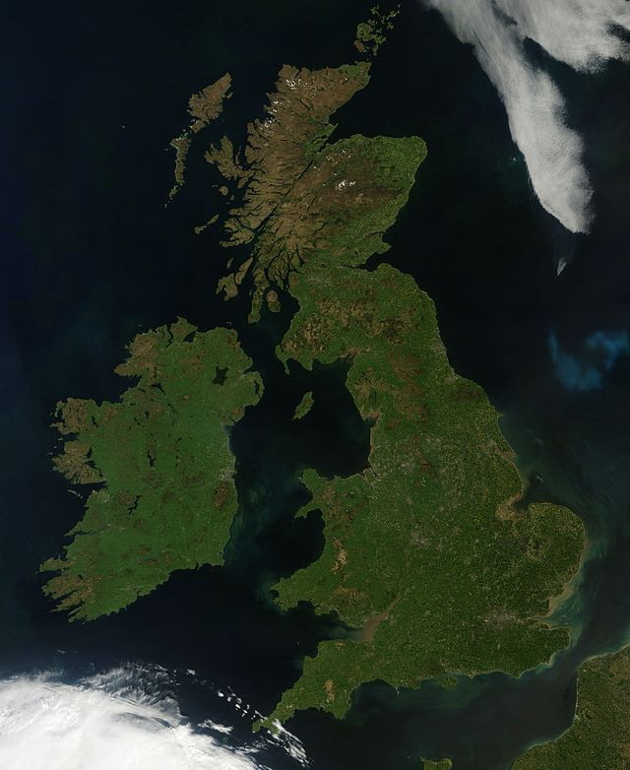
British Isles
Notes:
There was a time when the British Isles were not populated, there were no humans living here.

Slide 14
How many thousands of years ago do you think the first humans came and settled on these islands?
Notes:
There was a time when the British Isles were not populated, there were no humans living here.
The earliest evidence of humans living on these islands is from 40,000 years ago. However human settlement was sporadic, changes in the climate meant there were times when no humans lived here.

Slide 15
40,000 years ago
Continuous settlement 12,000 years ago
Notes:
The earliest evidence of humans living on these islands is from 40,000 years ago. However human settlement was sporadic, changes in the climate meant there were times when no humans lived here. When Ice ages occurred human populations either died out or moved away.
Uninterrupted or continuous human settlement on these islands dates from about 12,000 years ago. Everyone living on these islands is descended from people who arrived from elsewhere.

Slide 16
Every single person living on these islands is descended from people who arrived here from elsewhere, it may be from a long way back but we are all, in a sense, immigrants.

Slide 17
ancestor, ancestry
origin, origins
heritage
descend from, descendants
Notes:
As a follow-up pupils could ask their parents about any origins/ancestry for other countries. It is important that those children whose families have been rooted in one place for generations or have no traceable ancestry from elsewhere do not feel left out, emphasise that belonging to one place is also something to be proud of, being rooted in an area is great.
An alternative follow up would be to find other famous British people who have origins or ancestry from elsewhere.

