Slide 1
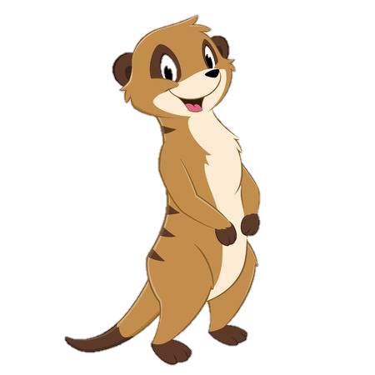
ENGLISH
As Writers, we shall begin our term by reading ‘Meerkat Mail’ by Emily Gravett. We shall use the characters in the book to write letters and diary entries from the perspective of a character in the story. We shall then learn an oral version of ‘Meerkat Mail’ which we shall innovate to write our own story in which our character visits Little Stoke Primary School. Towards the end of the term, we shall be writing an information report ‘All about Whales’ using ‘The Whale song’ by Dylan Sheldon as inspiration.
MATHEMATICS
As Mathematicians, we will be using our knowledge to measure and record the height of plants and the capacity of water. We shall also be measuring and comparing the heights and length of mother and baby animals. Later in the term we shall apply our knowledge of fractions to divide and share amounts of food whilst compiling an ‘Eat well’ plate. We will also be applying our maths to art by naming and drawing 2D shapes to create our own Mondrian inspired collage.
READING
As Readers, we will be looking at a range of fiction and non-fiction texts linked to our topic. We will focus on the vocabulary used in these books and discuss the meaning of new words linked to what we already know.
Colour our World- Welcome
to africa
Year 2 Term 3
HISTORY
As Historians, we will learn about the development of travel and transport throughout history. Alongside
consolidating the children's understanding of chronology through using timelines and making comparisons between old and new forms of transport, we will focus on early travel methods of the Vikings, through to the invention of cars, trains and aeroplanes. We will also look at the significant individual George Stephenson.
P.E (Wednesday)
As Gymnasts we shall create individual, paired and group balances and work towards creating a fluid movement from one balance to another using a variety of jumps and rolls.
Please ensure that your child has a full PE kit including trainers.
DT
As Designers, we will learn about good food hygiene rules and using kitchen equipment to prepare food safely. Children will apply these skills when making and evaluating a healthy dip and dippers. We shall develop children’s understanding of the ‘Eat well’ plate and explain the importance of eating a healthy and varied diet.
SCIENCE
As Scientists, we will learn about how humans and other animals are born, grow and change, and what we need to survive and be healthy. We will classify different kinds of animal babies, learn about the basic needs that are shared by humans and animals, and research the differing needs of animals within our care. Focusing their own experiences, children will explore the need for humans to eat a varied diet, to keep themselves clean, and to take regular exercise. Throughout the unit we will encourage children to make positive choices that contribute to a healthy lifestyle.
GEOGRAPHY
As Geographers, we will study the geography of Kenya through focusing on the main human and physical features of the country. Children will learn about the key geographical features of the country including Kenyan wildlife, landscapes and culture. Children will learn about the similarities and differences between Kenya and the UK along with continuing to develop their geographical skills through a variety of fun and interactive activities.
COMPUTING
As Computer technicians, we will focus on Online Safety. We shall look at safe searches and features on websites which are there to keep us safe. We will learn about our ‘digital footprint’ and discuss information which is safe to share and that which is personal and should be kept private.
ART
As Artists, we will be studying the work of Mark Rothko in order to explore colour mixing. We shall then create some African inspired art based on the Maasai culture. Towards the end of the term we shall create shape collages based on the work of Piet Mondrian.
WIDER CURRICULUM
January 23rd Tales by Torchlight
5th February – Safer Internet Day

