Slide 1
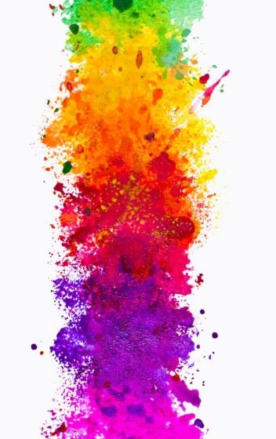
ENGLISH
As Writers, we will be using a range of different books linked to the theme of colour. These include, ‘Rainbow crow’ by Naomi Howarth, ‘Aurora’ by Mindy Dwyer which is a story about the northern lights. We will have the opportunity to write for a range of purposes including instruction texts about how to make a kaleidoscope and narratives which use gripping word choices and strong plots. We will learn about figurative language based on a character who will fly to the sun and we will finishing the term by following the Christmas story and writing a variety of poems.
MATHEMATICS
As Mathematicians, we will be using all methods of calculation to complete a real life budgeting investigation for bonfire night. Further to this, we will be using natural materials to make mandalas and create symmetrical patterns and exploring mathematical concepts around time and daylight. This is in addition to our daily maths lessons.
READING
As Readers, we will continue to explore the illuminate theme through a wide variety of fiction and non-fiction. We will use these books to develop our understanding of the language within our topic which we will use to enhance our writing. We will continue to develop our comprehension skills through retrieving and recording key information in order to justify our understanding of a text.
ILLUMINATE! Take two
Year 3 – Term 2
P.E(Wednesday and Forest School on Thursday)
As Dancers, we will be break dancing with control, fluency and attitude. We will create routines with standing, jumping, linking and floor moves.
We will also be taking part in forest school this term so children will need their forest school kits every Friday this term.
Please ensure that your child has clothes for forest school including wellies as children will be going outside whatever the weather. They will need hats, coats and gloves in preparation for the colder weather.
HISTORY
As Historians, we are going to be carrying out a focused study on the history of lighthouses. It will begin by looking at why lighthouses were created and built. We will then be focusing on how they have affected culture and trade and specifically the importance of specific lighthouses such as the Statue of Liberty.
SCIENCE
As Scientists, we will be discovering how magnets and forces are used in our daily lives. We will carry out enquiries to answer our own questions that we have about this area of science and investigate how compasses help us understand poles.
DT
As Designers, we will be making our own kaleidoscopes. We will be cutting and measuring precisely so that our finished product is of the highest standard. Our design process will include drawing exploded diagrams for others to follow and will link in to our instructional writing.
ART
As Artists, we will be working intensively on our painting and drawing skills during art week and continuing to look at how artists use warm and cool colour. We will be receiving and giving feedback and learning about the importance of this when creating a finished piece. To conclude, we will be sketching, sculpting and finishing a figurine based on the works of Alberto Giacometti.
GEOGRAPHY
As Geographers, we will be focussing our learning the on Scandinavian countries and others which lie in Northern Europe. We will also carry out a short study on the Northern Lights and link this to our writing in English. To conclude our term, we will find out about animals that migrate in search of warmer climates.
WIDER CURRICULUM
This term we have number of exciting events happening in school:
w/b 5th November – Art week
w/b 12th November –Anti-bullying/internet safety week
PARENT EVENT – 23rd November from 2pm.

