Slide 1
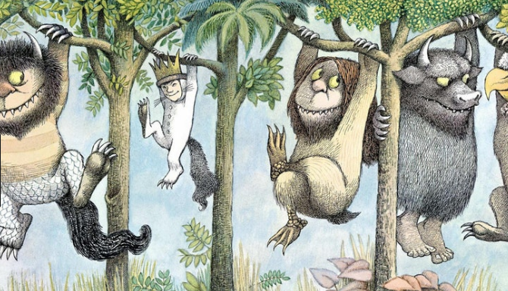
Where the Wild Things Are!
Year 4
Term 5
MATHS
As mathematicians, we will be investigating the area of different animal enclosures at Bristol Zoo and Noah’s Ark Zoo Farm. We will also be collecting data on people’s favourite animals and displaying this data in graphs ready to be analysed. This is in addition to our daily maths lesson.
ENGLISH
As writers, we will be looking at a variety of texts all around the topic of animals including: ‘The Wolves in the walls’ by Neil Gaiman, ‘Jumanji’ by Chris Van Allsburg and ‘Where the Wild Things Are’ by Maurice Sendak. From these texts we will be writing for a range of purposes. We will be researching and creating an information leaflet on Bristol Zoo. We will be participating in a debate about whether a zoo really is the best place for animals.
GEOGRAPHY
As geographers, we will be looking at physical and human characteristics of different locations for zoos in Bristol. We will then be deciding which location is best for a zoo and why. As geographers, we will be designing our own perfect zoo, which has all of the necessary physical and human characteristics needed.
READING
As readers, we will be using a wide range of fiction and non-fiction texts, many of these linked to our theme work. We will be enhancing our skills at making inferences and picking out vital information from texts. We will also be looking at writing formal written answers to questions about the texts.
SCIENCE
As scientists we will be looking at animals including humans. We will be learning about the beginnings of the digestive system and how teeth play their role. We will also be comparing different teeth from different animals.
History
As historians, we will be researching the history of Bristol Zoo. We will be comparing how it started out to what it looks like now. We will also be compiling a time line on the history of Bristol Zoo.
P.E.
As athletes we will be learning new skills. We will looking at different ways in which to compete in a variety of track and field events; such as sprinting, throwing and jumping. Please ensure that your child has a full PE kit, including trousers and trainers as we may be outside.
THE WIDER CURRICULUM
This term we have a number of exciting events happening in school:
24th April: Class trip to Bristol Zoo
1st and 2nd May: Shakespeare Workshops
7th May: Rob Mitchell Visit
17th May: Intra-School Cross Country Event
ART and DT
As artists, we will be looking at the works of Henry Moore and recreating our own sculptures based on his pieces.

Slide 2
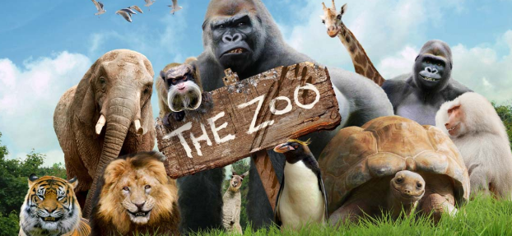
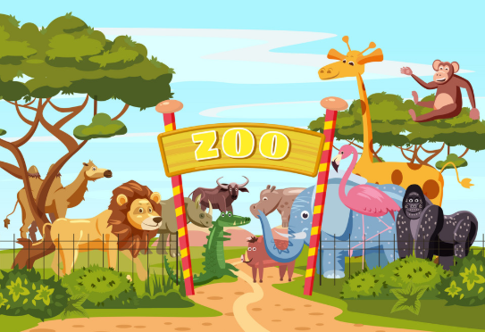
Homework Challenge Year 4
Term 5
To be handed in by 22nd May
Research challenge
Find out about the largest, most famous zoos in the world.
Where are they?
What kind of animals do they have?
If you went there, what would you most like to do?
Create a fact file on an endangered animal.
What are they?
What do they look like?
How many are there?
Where do they live?
What else can you find out about them?
Creation challenge
Design your own zoo or safari park. Which animals would you have? How big would their enclosures be? Do they have enclosures?
Create the ideal habitat for your favourite animal.
Create the perfect habitat for your own wild thing/monster.
Writing Challenge
Write a story about a wild thing or monster.
Who is the monster/wild thing?
Where are they?
Who is your main character?
What goes wrong?
Do you meet any other creatures or monsters?
How does your story end?

