Slide 1
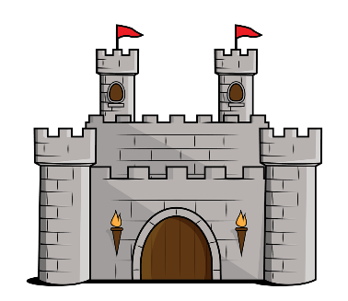
What a Knight!
Year 5 – Term 5
WRITING
As Writers, we will be completing work using to ‘The Snow Dragon’ by Vivian French and ‘Arthur and the Golden Rope’ by Joe Todd Stanton as a stimulus. This term we will be exploring different persuasive techniques and applying these to a range of different contexts that we may use in everyday life. Alongside this, we will also be continuing to develop our narrative skills as we work on building or character development within a more mature story plot. Throughout both of these units we will also be focusing on our self-editing skills and how we revise our work to make it better.
MATHEMATICS
As Mathematicians, we will be learning about fractions and decimals and the relationship between them. We will continue to develop our knowledge around what a fraction is and how to calculate using them. We will also use our calculation skills to add, subtract and multiply decimal numbers in a range of different contexts such as measurement and money. Linked to our topic on castles and knights, we will look at calculating the area and perimeter of given shapes and use these skills to design castles and settlement plots for our kingdoms.
READING
As Readers, we will be looking at a range of fiction and non-fiction texts linked to our topic. We will be developing our comprehension skills and in particular we will be focusing on our ability to pick up implied clues from the text and using multiple pieces of evidence from the text to support our ideas. Throughout the term we will be continuing to work on our written responses to questions.
HISTORY
As Historians, we shall be exploring the Medieval era with a particular focus this term on Castles. We will explore the different features of castles including successful ways to defend and attack them as well as understanding more about what life would have been like to live in a castle in Medieval times.
P.E (Wednesday)
As Athletes, we will be developing our athletic skills. We will be developing our techniques in different sports and thinking about ways in which we can improve. Please ensure that your child has a full PE kit.
GEOGRAPHY
As Geographers, we will learn about maps and the grid references used on them. As our confidence builds around using 4-figure grid references, we will begin to design our own maps linked to our topic and locate information using the references given.
ART
As Artists, we will looking at the work of Colin Thompson and his illustration work on fictional castles. We will use his pieces as inspiration to sketch our own and developing our 3D drawing skills as well as continuing to build on our prior knowledge of shading.
SCIENCE
As Scientists, we will be exploring animals and the metamorphic changes that they go through. We will learn about the lifecycles of different groups of animals and compare these to one another. We will begin to conclude why we believe them to be different and the impact this has on the different animal groups.
Music
As musicians, we will be learning, as a class, to play the J-Sax. We will learning how to read music and play as part of a wood wind orchestra.
WIDER CURRICULUM
Shakespeare Week (Hamlet) – w/b: 29th April
Camp 2020 Meeting – Thursday 2nd May @ 4pm

