Slide 1
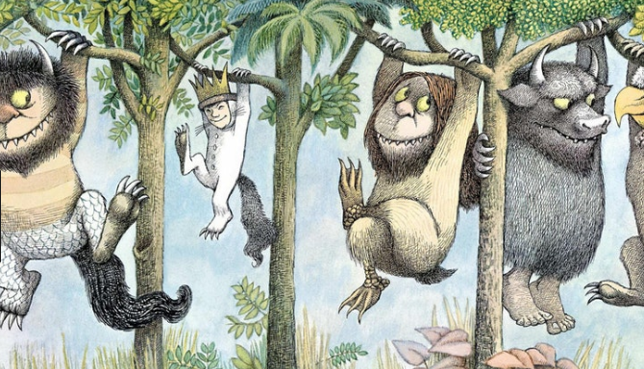
Where the Wild Things Are!
Year 4
Term 6
MATHS
As mathematicians, we will be investigating the area of different animal enclosures at Bristol Zoo and Noah’s Ark Zoo Farm. We will also be collecting data on people’s favourite animals and displaying this data in graphs ready to be analysed. This is in addition to our daily maths lesson.
ENGLISH
As writers, we will be looking at a variety of texts all around the topic of animals including: ‘The Wolves in the Walls’ by Neil Gaiman; ‘Jumanji’ by Chris Van Allsburg; ‘Fantastic Beasts and Where to Find Them’ by Newt Scamander and ‘Where the Wild Things Are’ by Maurice Sendak. From these texts we will be writing for a range of purposes. We will also be researching and creating an information leaflet on Bristol Zoo. We will be participating in a debate about whether a zoo really is the best place for animals.
GEOGRAPHY
As geographers, we will be looking at physical and human characteristics of different locations for zoos in Bristol. We will then be deciding which location is best for a zoo and why.
History
As historians, we will be researching the history of Bristol Zoo. We will be comparing it from when it was first built, to what it looks like now and all of the changes in between. We will also be compiling a time line on the history of Bristol Zoo.
READING
As readers, we will be using a wide range of fiction and non-fiction texts, many of these linked to our theme work. We will be enhancing our skills at making inferences and picking out the vital information from texts. We will also be looking at writing formal written answers to questions about the texts.
SCIENCE
As scientists we will be looking at animals including humans. We will be learning about the digestive system and food chains. We will be constructing and interpreting food chains as well as identifying predators and prey.
Computing
As IT technicians, we will be weather reporters. We will be describing and measuring the weather, analysing the data and recording and producing a final TV style weather report.
P.E.
As athletes we will be learning the skills to play netball and rounders. We will be focusing on our team skills and finding out the best way to play these games. Please ensure that your child has a full PE kit, including trousers and trainers as we may be outside.
THE WIDER CURRICULUM
This term we have a number of exciting events happening in school:
Swimming every afternoon: 4th-7th June
Sports day – 21st June

Slide 2
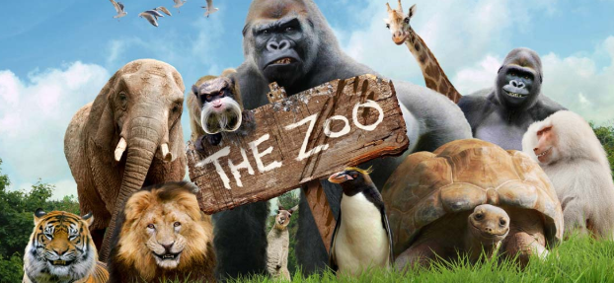
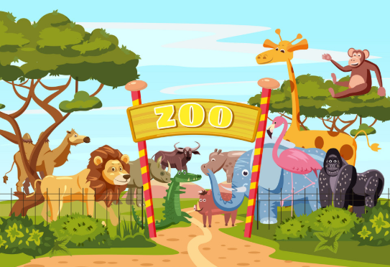
Homework Challenge Year 4
Term 6
To be handed in by 23rd July
Research challenge
Find out about animals from all over the world
Are there different animals in different parts of the world? Why?
Are some animals found all over the world?
Are there more tigers than bears?
Which animal is the strongest in the world?
Which animal is the largest in the world?
Create a PowerPoint presentation on your favourite animals.
Creation challenge
Create your own game which is based on animals.
Create your own ‘animal in the wild’ scene.
Design your own poster for your own zoo or safari park.
Writing Challenge
Write a diary as though you are an explorer in unknown lands.
Where are you?
What can you see?
What are you looking for?
What has happened?
Who is with you?
How do you feel?

