Slide 1
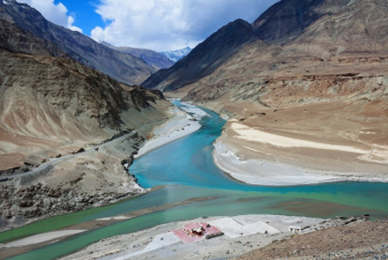
River Deep! Mountain High!
Year 4
Term 4
ENGLISH
As writers, we will be looking at a variety of texts all around the topic of rivers including: ‘The Pebble in my Pocket’ by Meredith Hooper and Chris Coady and ‘First to the Top’ by David Hill. From these texts we will be writing for a range of purposes. We will be writing a diary entry based on Sir Edmund Hilary’s first trek up Mount. Everest, simile poems based on rivers and haikus to describe the flow of water in a river. Alongside this we will be creating our own Rivers and mountains version of the game ‘Top Trumps’.
MATHS
As mathematicians, we will be focusing on capacity and using our knowledge to investigate the amount of rainfall in two different cities in the UK. We will also be using capacity to look closely at the water cycle. We will then be calculate the average amount of rain that we have in Little Stoke throughout the term. This is in addition to our daily maths lessons.
GEOGRAPHY
As geographers, we will be using atlases and maps to find mountain ranges from across the world and in the UK. We will be looking at the different mountains and their features. The class will be looking at how mountains are formed and what the climates of different mountains are like.
READING
As readers, we will be using a wide range of fiction and non-fiction texts, many of these linked to our theme work. We will be enhancing our skills at making inferences and picking out vital information from texts. We will also be looking at writing formal written answers to questions about the texts.
ART and DT
As artists, we will be creating a 3D model of a mountain range. We will be ensuring that we are including all of the features of both mountains and rivers.
SCIENCE
As scientists we will be looking at living things and their habitats. We will be looking into the characteristics of living things and how they can be grouped together in a variety of ways. We will be going out into the local area to look at the natural habitats around us.
P.E.
As footballers we will be learning new ball skills. We will looking at different ways in which to control and manipulate the ball. As swimmers we will be learning how to swim and how to improve our techniques. Please ensure that your child has a full PE kit, including trousers and trainers as we may be outside. Also, every Tuesday they will need a swimming kit.
THE WIDER CURRICULUM
This term we have a number of exciting events happening in school:
Every Tuesday afternoon year 4 will have swimming
7th March: World Book Day
7th and 8th March: Maths days
11th – 15th March: Science week
22nd March – Year 4 Parent event

Slide 2
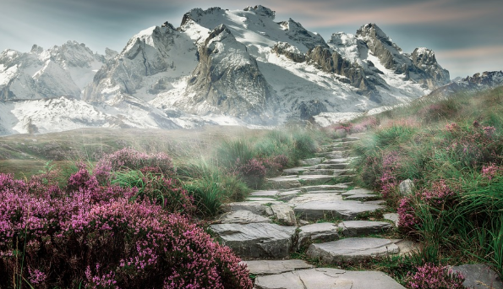
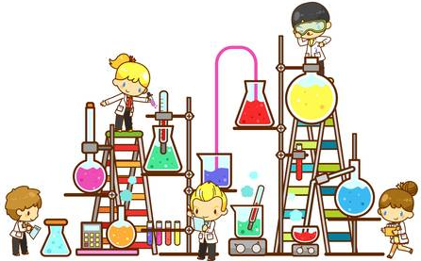
Homework Challenge Year 4
Term 4
To be handed in by 3rd April
Research and creation challenge
Pick one of the famous mountains below and create a fact file, picture or model of it.
Mount Fiji Mount Kilimanjaro
Mont Blanc K2
Matterhorn Table Mountain
Use the internet, or ask for information from the classroom in order to complete this research challenge.
Science challange
Look around your house find solids, liquids and gases. Take photos of yourself proving each one. Can you find any solids which behave like liquids?
Write instructions for how to make a vertebrate animal: reptile, amphibian, bird, mammal, fish or invertebrate: snails, slugs, worms, spiders or insects.
With an adult. Boil 100ml of water at different temperatures and time how long it takes to fully evaporate. Show your results in a bar graph.
Make your own ear muffs out of different materials, test to see which ones work best. Which ones provide the best insulation against sound?
Writing Challenge
Write a story about a mountain explorer trekking through the treacherous terrain of a mountainside.
Who is the explorer?
Where are they exploring?
What do they see?
What do they hear?
Do they meet any mountain creatures?
How does your story end?

