Slide 1
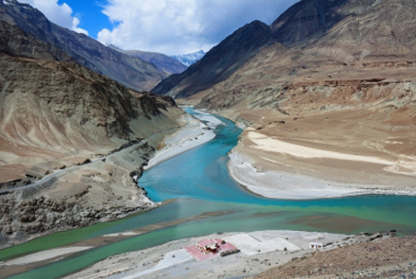
River Deep! Mountain High!
Year 4
Term 3
MATHS
As mathematicians, we will be focusing on capacity and using our knowledge to investigate the amount of rainfall in two different cities in the UK. We will also be using capacity to look closely at the water cycle. We will then be calculate the average amount of rain that we have in Little Stoke throughout the term. This is in addition to our daily maths lesson.
ENGLISH
As writers, we will be looking at a variety of texts all around the topic of rivers including: ‘Flotsam’ by David Wiesner and ‘A River’ by Marc Martin. From these texts we will be writing for a range of purposes. We will be writing an explanation text on the water cycle, a narrative based on a river’s journey, simile poems based on rivers and haikus to describe the flow of water in a river. Alongside this we will be creating our own rivers and mountains version of the game ‘Top Trumps’.
GEOGRAPHY
As geographers, we will be looking how rivers are formed and at the different areas of a river. We will be looking at the journey the river water takes from the source to the mouth. We will also be researching different famous rivers from around the world and making comparisons between them
READING
As readers, we will be using a wide range of fiction and non-fiction texts, many of these linked to our theme work. We will be enhancing our skills at making inferences and picking out vital information from texts. We will also be looking at writing formal written answers to questions about the texts.
ART
As artists, we will be honing in on our drawing and painting skills to create various drawings of rivers. We will be exploring what it is like to paint on different surfaces, e.g. sand. By the end of the term we will have created a 3D model of a river flowing down from it’s source to it’s mouth.
SCIENCE
As scientists, we will be studying different states of matter. We will be investigating the differences between solids, liquids and gases. We will be discovering how particles behave in the different states of matter. We will also be looking and studying the Water Cycle.
P.E.
As gymnasts we will be learning new gymnastic skills. We will looking at different ways in which to jump and balance with our bodies in creative ways. Please ensure that your child has a full PE kit, including trousers and trainers as we may be outside.
THE WIDER CURRICULUM
This term we have a number of exciting events happening in school:
10th-14th February – Swimming
History week – We will be studying the
Ancient Greeks

Slide 2
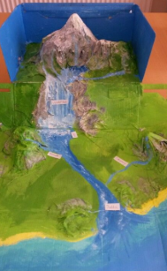
Homework Challenge Year 4
Term 2
To be handed in by 13TH February
Writing Challenge
Write a non-chronological report about animals that live in a river.
What animal is it?
Why does it like the river?
What does it eat?
Does it swim?
Does it live underwater, or on the riverbed?
Research challenge
Pick one of the famous rivers below and create an information leaflet on them.
River Nile Amazon River
Ganges Rhine
River Thames Yangtze
Use the internet, or ask for information from the classroom in order to complete this research challenge.
Creation Challenge
Draw and label a picture or model of a river.
Create a poster about animals that live near the river.

