Slide 1
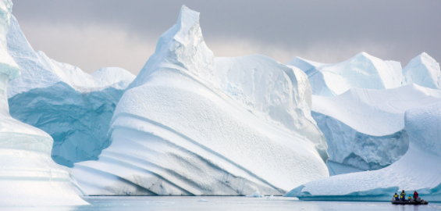
Poles Apart!
Year 2
Term 2
MATHS
As mathematicians, we will be focusing on collecting a variety of data and showing this in different ways. We will be making Venn diagrams, tally charts and pictograms. We will also be using our map skills and learning the points of a compass.
ENGLISH
As writers, we will be looking at a variety of texts all around the topic of polar regions including; ‘Poles Apart’ by Jeanne Willis, ‘The Rainbow Bear’ by Michael Morpurgo, ‘The Big Book of the Blue’ by Yuval Zommer and ‘Shackleton’s Journey’ by William Grill. We will be using these texts to write an information leaflet on the Inuit people, diary entries as through we are in the Arctic and we will be writing postcards to explorers.
GEOGRAPHY
As geographers, we will be comparing seasons in the UK to seasons in the Arctic. We will be looking at the six climate zones of the world and seeing how they compare to the UK. We will be looking closely at the physical and human features in the Arctic and how different it is to the UK. We will also be looking at the continents and oceans of the world.
HISTORY
As historians, we will be learning about Christopher Columbus, John Cabot, Robert Falcon and Roald Amundsen. We will be learning about their explorations. We will also be looking in the life of traditional Inuit’s and how their lives have changed over time.
READING
As readers, we will be using a wide range of fiction and non-fiction texts, many of these linked to our theme work. We will be enhancing our skills at making inferences and picking out vital information from texts. We will also be looking at writing formal written answers to questions about the texts.
ART
As artists, we will be honing our sculpting, painting and printing skills to create a variety of pieces around the polar regions. We will be creating landscapes, Inuit sculptures and Aurora Borealis chalk pastel paintings. We will also be taking inspiration from Henri Rousseau to create a habitats collage.
SCIENCE
As scientists, we will be looking at animals and humans. We will be looking at how animals get their food from plants and other animals. We will be looking at habitats and how different animals thrive in different habitats and why. We will also be looking at planting and growing plants.
P.E.
As curlers we will be learning new strategic skills to master the ability to play new age curling. As dancers we will be learning how to move around the room and to follow the beat of the music. Please ensure that your child comes to school in a PE kit on Thursdays and Fridays.
THE WIDER CURRICULUM
This term we have a number of exciting events happening in school:
13th November – Children in Need

Slide 2
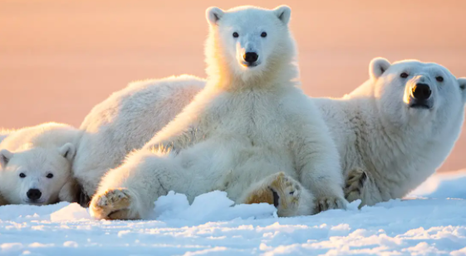
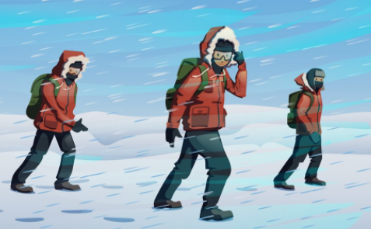
Homework Challenge Year 2
Term 2
To be handed in by 17th December
Writing Challenge
Write a magical story about a journey to the North Pole.
Who is the explorer?
Why are they going there?
How do they get there?
What happens when they get there?
Research challenge
Pick an animal from one of the polar regions and research them:
Polar bear Penguin
Narwhal Arctic Fox
Arctic hare Walrus
Use the internet, or ask for information from the classroom in order to complete this research challenge.
Creation Challenge
Create an igloo out of items found in your home
Create a poster about how people fish in the Arctic
Design your own polar regions outfit. Remember you would need to keep warm!

