Slide 1
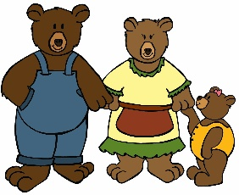
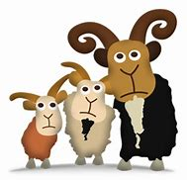
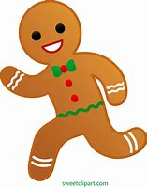
Physical Development
We will continue to have our PE session on Mondays. This term we will be looking at balls skills, throwing and catching, dribbling balls and using a bat and ball.
The children start each day with a handwriting session. This is an opportunity to practise forming the letters correctly so that this becomes natural for them.
Spending time in Forest School and in the outdoor classroom also gives lots of opportunities to develop gross motor skills and many inside activities such as building, colouring, painting and cutting all help to develop out fine motor skills.
Once upon a time
Kipling class – term 3
English
This term we will be starting ‘drawing club’. This is an opportunity to develop our imaginations, vocabulary, literacy and maths skills through different stories.
We will continue to learn phonic sounds and keywords and will be using these to read and write words and sentences. The children will be writing captions and sentences focusing on capital letters, finger spaces and full stops. There will be lots of opportunities to develop these skills during adult directed activities and during discovery time.
Our aim is for the children to become fluent readers so we will be continuing to read with the children regularly. Please support us with this by reading regularly with your child at home and writing in their dairies. Each read at home is one step closer to a reading certificate.
This term we will be sharing lots of different traditional tales, for examples Goldilocks and the Three bears, The Three Billy Goats Gruff and The Gingerbread Man.
Personal, Social and Emotional Development
This term we will be looking at Dreams and goals. We will be thinking about resilience and what we can do when we encounter a challenge or find something difficult. We will be encouraging the children to be more independent in their learning and to have a go at an activity without an adult. We will continue to talk about emotions and how to manage these effectively.
Understanding the World
We will be completing simple science experiments and making observations. We will be investigating different materials and their properties. We will be using this information to make a boat to help the gingerbread man across the river.
We will be cooking some gingerbread men this term. During these sessions we will be looking at the changes that happen when we mix ingredients and what happens when they are cooked.
We will continue to go to Forest school on Fridays. We will be finding out more about the forest. Looking carefully at nature and making sure we are looking after the environment.
In our history sessions we will be thinking about the ‘Granny’ in the story and how things have changed since she was a child.
Communication and Language
We will be retelling lots of stories this term and changing our voices to make them as exciting as we can.
We will be learning how to give our opinions and that agreeing or disagree with one another is ok. We will be learning phrases that will help us with his. We will be learning lots of new words during the term, as part of drawing club the children will learn 6/8 new words each time.
Maths
This term in maths we will be looking at
Alive in 5
Introducing zero; Comparing numbers to 5
Composition of 4 and 5 ; Comparing mass and capacity
We will continue to look at the number system, ensuring we are counting accurately and understand where they come in the number system. We well be challenging the children to develop their maths skills during discovery time. For example adding up their score during a aiming game.
Expressive Arts and Design
This term we will be exploring the junk modelling box to make many different things. We will be learning about different techniques to attach things together. We will be using musical instruments when retelling the stories and giving reasons why we have chosen certain sounds / instruments for the different parts.
Please remember to add hours to your child’s children’s university passport / account – our weekly forest school sessions and reading at home count towards this.

